Slide 1
Distributed System
by
Mr Alok Tiwari
(CSE Department)
KIET Group of Institutions

Slide 2
Contents
Failure Recovery in Distributed System
Forward and Backward recovery

Slide 3
Recovery
Computer system recovery:
  Restore the system to a normal operational state
Process recovery:
  Reclaim resources allocated to process, Undo modification made to databases, and Restart the process Or restart process from point of failure and resume execution

Slide 4
Recovery
Distributed process recovery (cooperating processes):
  Undo effect of interactions of failed process with other cooperating processes.
System:
  Set of hardware and software components
  Designed to provide a specified service (I.e. meet a set of requirements)

Slide 5
Recovery
    System failure:
      System does not meet requirements, i.e.does not perform its services as specified
    Erroneous System State:
      State which could lead to a system failure by a sequence of valid state transitions
      Error: the part of the system state which differs from its intended value
    Fault:
      Anomalous physical condition, e.g. design errors, manufacturing problems, damage, external disturbances.

Slide 6
Classification of failures
    Process failure:
      Behavior: process causes system state to deviate from specification (e.g. incorrect computation, process stop execution)
      Errors causing process failure: protection violation, deadlocks, timeout, wrong user input, etc…
      Recovery: Abort process or Restart process from prior state
    System failure:
      Behavior: processor fails to execute
      Caused by software errors or hardware faults (CPU/memory/bus/…/ failure)
      Recovery: system stopped and restarted in correct state
      Assumption: fail-stop processors, i.e. system stops execution, internal state is lost

Slide 7
Classification of failures
    Secondary Storage Failure:
      Behavior: stored data cannot be accessed
      Errors causing failure: parity error, head crash, etc.
      Recovery/Design strategies:
        Reconstruct content from archive + log of activities
        Design mirrored disk system
    Communication Medium Failure:
      Behavior: a site cannot communicate with another operational site
      Errors/Faults: failure of switching nodes or communication links
      Recovery/Design Strategies: reroute, error-resistant communication protocols

Slide 8
Backward and Forward Error Recovery
Failure recovery: restore an erroneous state to an error-free state
Approaches to failure recovery:
  Forward-error recovery:
    Remove errors in process/system state (if errors can be completely assessed)
    Continue process/system forward execution
  Backward-error recovery:
    Restore process/system to previous error-free state and restart from there

Slide 9
Comparison: Forward vs. Backward error recovery
  Backward-error recovery
    (+) Simple to implement
    (+) Can be used as general recovery mechanism
    (-) Performance penalty
    (-) No guarantee that fault does not occur again
    (-) Some components cannot be recovered
  Forward-error Recovery
    (+) Less overhead
    (-) Limited use, i.e. only when impact of faults understood
    (-) Cannot be used as general mechanism for error recovery

Slide 10
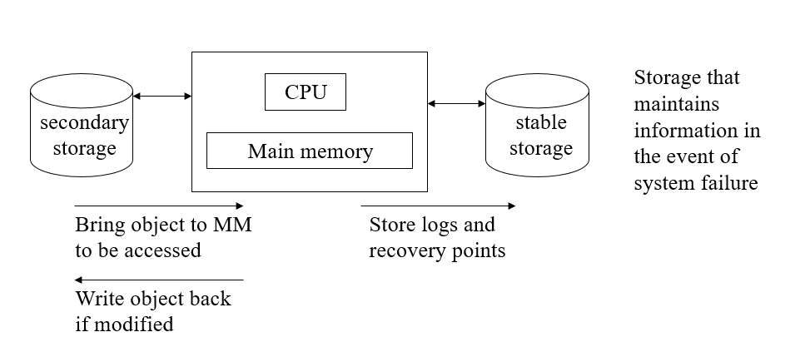
Backward-Error Recovery: Basic approach
Principle: restore process/system to a known, error-free “recovery point”/ “checkpoint”.
System model:

Slide 11
Approaches:
  Operation-based approach
  State-based approach

Slide 12
The Operation-based Approach
Principle:
  Record all changes made to state of process (‘audit trail’ or ‘log’) such that process can be returned to a previous state
  Example: A transaction based environment where transactions update a database
    It is possible to commit or undo updates on a per-transaction basis
    A commit indicates that the transaction on the object was successful and changes are permanent

Slide 13
State-based Approach
  Principle: establish frequent ‘recovery points’ or ‘checkpoints’ saving the entire state of process
  Actions:
    ‘Check pointing’ or ‘taking a checkpoint’: saving process state
    ‘Rolling back’ a process: restoring a process to a prior state
  Note: A process should be rolled back to the most recent ‘recovery point’ to minimize the overhead and delays in the completion of the process

Slide 14
Thank
You

